Slide 1
in education
January 2024
Dr. Isabel Fischer
Information Systems, Management and Analytics
AI

Slide 2
Agenda
While we wait and before we start: Some links to AI-related work
Context
Exploring the potential of an AI-based formative feedback tool
Practical strategies for integrating generative AI into your teaching practices
  Understanding the paradoxical tensions of identity that influence AI adoption in the classroom
  Employing a sensemaking lens to interpret students' and educators' perceptions of students’ use of generative AI (when asked to use generative AI)
Discussion

Slide 3
Some links
AI in education resources: https://warwick.ac.uk/fac/cross_fac/academy/activities/learningcircles/future-of-learning/
AI in higher education report:
  https://warwick.ac.uk/fac/cross_fac/academy/activities/learningcircles/future-of-learning/ai_education.pdf
Fischer, I. and Dobbins K. 2023, Is it worth it? How paradoxical tensions of identity shape the readiness of management educators to embrace transformative technologies in their teaching, Journal of Management Education, https://doi.org/10.1177/10525629231201843
Fischer, I. 2023, Evaluating the ethics of machines assessing humans The case of AQA: An assessment organisation and exam board in England. Journal of Information Technology Teaching Cases, https://doi.org/10.1177/20438869231178844
Fischer, I., Beswick, C. and Newell, S. 2021, Rho AI – Leveraging artificial intelligence to address climate change : financing, implementation and ethics, Journal of Information Technology Teaching Cases, https://journals.sagepub.com/doi/full/10.1177/2043886920961782.

Slide 4
More links
A call for your AI work (Pearls of practical wisdom and short case studies):
  https://docs.google.com/document/d/1RVgBHAnDGfi28VVTjHQchJ7Sf-zNMwRo7jH4DbtebOg/edit
JISC (2022) Interested in receiving formative feedback on your draft essays and dissertations on demand? Introducing Warwick’s “AI Essay-Analyst” https://nationalcentreforai.jiscinvolve.org/wp/2022/11/16/interested-in-receiving-formative-feedback-on-your-draft-essays-and-dissertations-on-demand-introducing-warwicks-ai-essay-analyst/.
JISC (2022), AI Map UK https://exploreai.jisc.ac.uk/ai-map.
Times Higher Education (THE) Campus Pedagogic (2023) Paradigm 4.0: bringing students, educators and AI together, https://www.timeshighereducation.com/campus/pedagogic-paradigm-40-bringing-students-educators-and-ai-together.
CABS - Chartered Association of Business Schools (2023) AI in (higher) education: A call for sector-wide collaboration, https://charteredabs.org/ai-in-higher-education-a-call-for-sector-wide-collaboration/.

Slide 5
There is no single AI, we are using AI as an umbrella term.
Similarly, we are not specific on generative AI (GenAI).
Transformers
/ LLMs
GPT
BERT
Foundation Models
Deep Learning
with multilayered
neural networks
Machine Learning
based on algorithms
AI
Artificial Intelligence
Fischer (2023): https://doi.org/10.1177/20438869231178844

Slide 6
Text
Four examples below chosen as very easy to use and ‘free’
(in exchange of your data)
OpenAI: https://openai.com/dall-e-2 (see previous page, links to ChatGPT), and also here: https://chat.openai.com
Bing (using Microsoft Edge): The New Bing (www.bing.com/new)
Bard (google): https://bard.google.com/chat
Claude (Anthropic): https://claude.ai/login?returnTo=%2F
https://www.turing.com/resources/generative-ai-tools

Slide 7
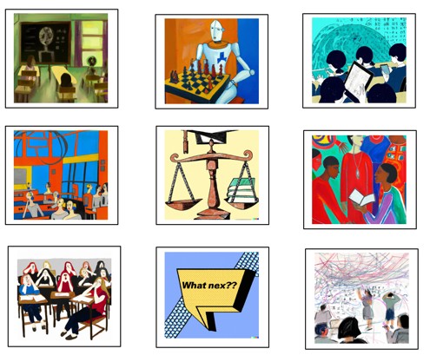
Images and videos
Two examples below chosen as very easy to use and with ‘free credits’
OpenAI: https://openai.com/dall-e-2 (also link for ChatGPT if you have not already signed up to it)
Haygen: https://app.heygen.com/home
Uploading your picture or using one of theirs,
You can write a text – and if over 30 seconds you can
Get it translated into other languages.
Example: Birthday message I produced with two different
Images and in two different languages:
https://app.heygen.com/share/01c00059b31a41e29e4cdc25acd7292d
https://app.heygen.com/share/428214b6c7c34597922dbc3c28ace2b3
https://app.heygen.com/video-translate/share/eaae8994ab0d43f68bd0c780ee39395b

Slide 8
‘Pre-GPT’, I deployed AI (BERT) with an aim to democratise Education
Fischer (2023): https://doi.org/10.1177/20438869231178844

Slide 9
Grammar suggestions, readability scores, visualisations
(below argumentative zoning and summary of strengths and weaknesses of writing in a spider graph),
CABS quality of refs, also sentiment analysis etc.
ISSN | Field | Journal Title | AJG 2021
1846-3363 | ETHICS-CSR-MAN | management | 1
1526-548X | MKT | marketing science | 4*

Slide 10
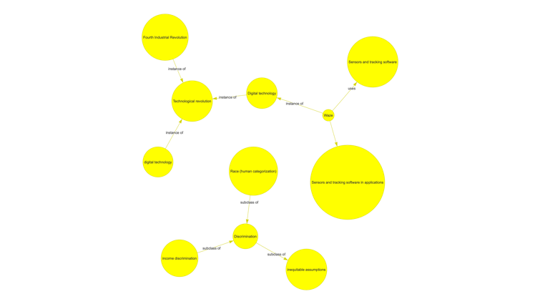
The tool is particularly effective for dissertations, longer essays and for draft journal articles. Also working for 500-word formative essays but less insightful.
https://nationalcentreforai.jiscinvolve.org/wp/2022/11/16/interested-in-receiving-formative-feedback-on-your-draft-essays-and-dissertations-on-demand-introducing-warwicks-ai-essay-analyst/
https://blogs.warwick.ac.uk/wjett/entry/introducing_warwicks_ai/
Graph to the left:
Knowledge graph

Slide 11
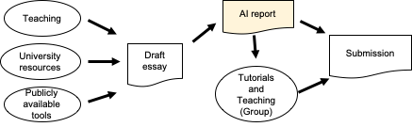
Personalised learning integrated into the classroom:
Learner-facing AI for augmented formative feedback

Slide 12
Differentiate (and advocate to differentiate) between low-stakes and high-stakes environments
AES = Automated Essay Scoring
Fischer, I. 2023, Evaluating the ethics of machines assessing humans The case of AQA: An assessment organisation and exam board in England. Journal of Information Technology Teaching Cases, https://doi.org/10.1177/20438869231178844

Slide 13
What do you think:
  1) How did students react,
  2) How did educators react,
  3) How did IT react,
  4) How did other stakeholders react?
  What were each of the stakeholder’s concerns?

Slide 14
Evolving student reaction following the introduction of various student-facing initiatives in the classroom
Business applications
Of emergent
technologies
(Esports, VR,
Metaverse);
VR apps to try;
Plus AI-formative
Feedback.
“Fantastic.
Loads of exciting
Opportunities”
AI for ESG
Investing.
“Fun. One day
it will be great.”
AI-based
Formative
Feedback
Tool; AI Ethics
ctd.
“Interesting.
But not as
good as
humans.
Covid is still
more important.”
Generative AI,
AI Ethics (students as
stakeholders);
& Taking the ‘AI’
out of the formative
feedback tool.
“It’s happening
and I am worried
about my future
employment”
AI Ethics
(esp. risks),
Business context
“Important
Aspects.
A bit abstract.
Not for the
near future.
Covid is more
important”
2018/19
2019/20
2020/21
2021/22
2022/23
Fischer & Dobbins (2023) – Journal of Management Education
Is it Worth it? How Paradoxical Tensions of Identity Shape the Readiness of Management Educators to Embrace Transformative Technologies in their Teaching https://journals.sagepub.com/doi/10.1177/10525629231201843

Slide 15
Paradoxical tensions of identity that influence AI adoption in the classroom
Fischer & Dobbins (2023) – Journal of Management Education
Is it Worth it? How Paradoxical Tensions of Identity Shape the Readiness of Management Educators to Embrace Transformative Technologies in their Teaching https://journals.sagepub.com/doi/10.1177/10525629231201843

Slide 16
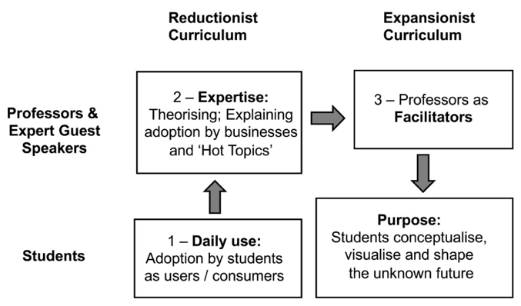
AI needs to be embedded within
Processes and Pedagogy
Fischer & Dobbins (2023) – Journal of Management Education
Is it Worth it? How Paradoxical Tensions of Identity Shape the Readiness of Management Educators to Embrace Transformative Technologies in their Teaching https://journals.sagepub.com/doi/10.1177/10525629231201843

Slide 17
That was my first ‘Pearl of practical wisdom’ – Reminder, a call for your AI work (Pearls of practical wisdom and short case studies):
  https://docs.google.com/document/d/1RVgBHAnDGfi28VVTjHQchJ7Sf-zNMwRo7jH4DbtebOg/edit

Slide 18
Before I move to the second ‘Pearl of Practical Wisdom’: All our resources from an interdisciplinary student and staff group that reviewed Opportunities and Risks of AI can be found here: https://warwick.ac.uk/fac/cross_fac/academy/activities/learningcircles/future-of-learning/
Feedback & dialogues with AI
Chapter 5
Supporting infrastructure, Agile processes, and a
culture of innovation
Chapter 6
AI-enhanced learning environment
Chapter 1
Ethics and Academic Integrity,
with and without AI
Chapter 3
Assessments:
Chapter 4
Teaching of the future
Chapter 2

Slide 19
Example Assessment
Individual
2500 words
1500-word scholarly blog, establishing you as an expert (underpinned by academic literature).
Include images.
500-word AI reflection
500-word margin for images with text / quotes
Sample: https://blogs.warwick.ac.uk/wjett/entry/scholarly_blogs_part/

Slide 20
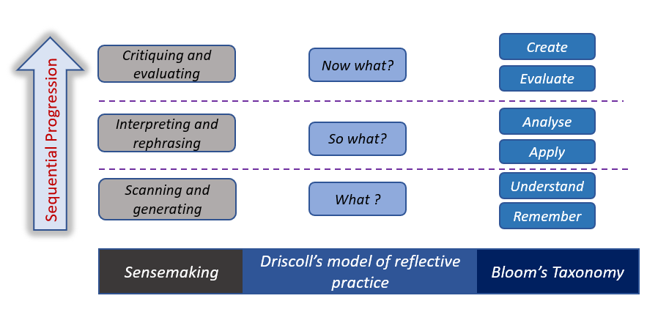
Employing a sensemaking lens to interpret students' and educators' perceptions of students’ use of generative AI
(when being asked to use GenAI)
Making Sense of Generative AI for Assessments: Contrasting Student Claims and Assessor Evaluations
Isabel Fischer*, Simon Sweeney**, Matthew Lucas***, and Neha Gupta*
* University of Warwick, Warwick Business School, Coventry, UK
** University of York, York, UK
*** IBM, Hursley, UK & University of Warwick, Warwick Business School, Coventry, UK
Preuss, L., Fletcher, I., & Luiz, J.M. (2023). Using sensemaking as a lens to assess student learning on corporate social responsibility and sustainability. Higher Education Quarterly. https://doi.org/10.1111/hequ.12429

Slide 21
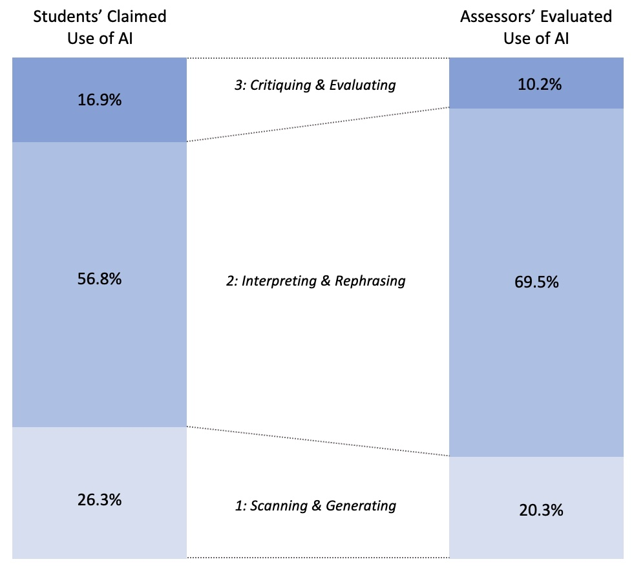
Employing a sensemaking lens to interpret students' and educators' perceptions of students’ use of generative AI
(when being asked to use GenAI)
Making Sense of Generative AI for Assessments: Contrasting Student Claims and Assessor Evaluations
Isabel Fischer*, Simon Sweeney**, Matthew Lucas***, and Neha Gupta*
* University of Warwick, Warwick Business School, Coventry, UK
** University of York, York, UK
*** IBM, Hursley, UK & University of Warwick, Warwick Business School, Coventry, UK

Slide 22
Questions and Discussion.

Slide 23
Thank you

